Slide 1

Getting started with report writing using Quarto
January 23, 2024
8:00 pm - 9:30 pm (GMT +3)

Slide 2
Agenda
Time | Activity | Speaker/ Moderator
8:00 pm – 8:05 pm | Participants joining
8:05 pm – 8:15 pm | Welcoming remarks and introducing the speaker | Njoki Lucy
8:15 pm – 9:00 pm | Talk | Isabella C. Velásquez
9:00 pm – 9:15 pm | Q & A | Njoki Lucy
9:15 pm – 9:20 pm | Closing remarks | Njoki Lucy

Slide 3
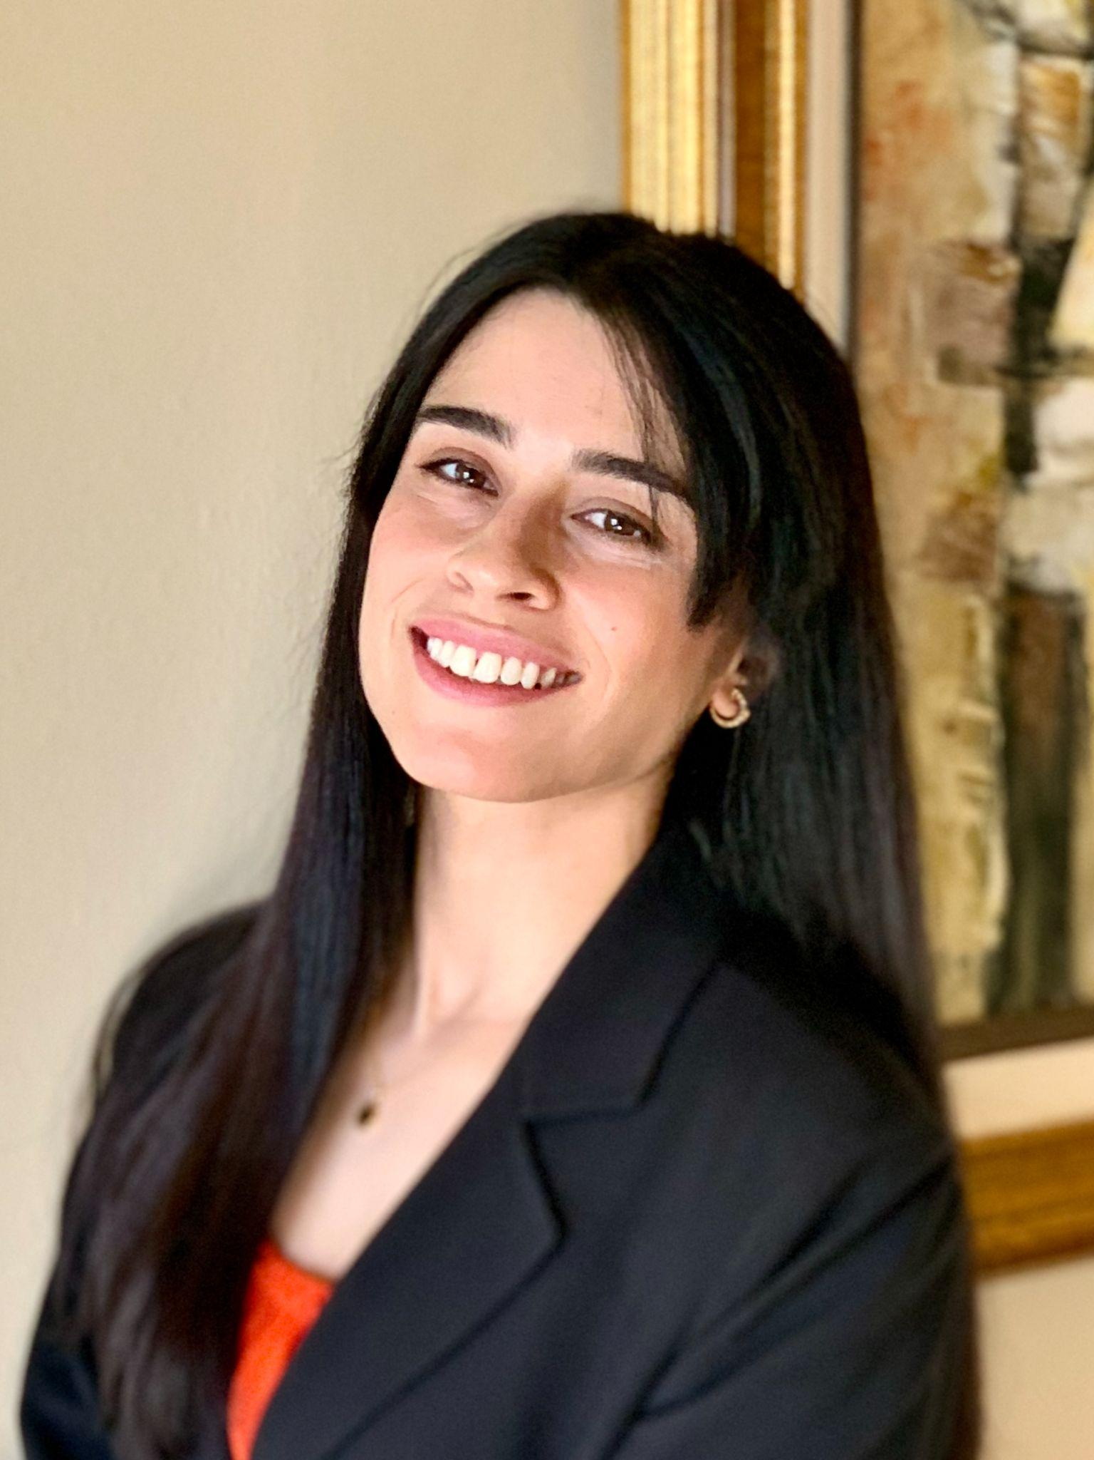
Our Speaker
Isabella C. Velásquez
Senior Product Marketing Manager at Posit Software (formerly RStudio)

Slide 4
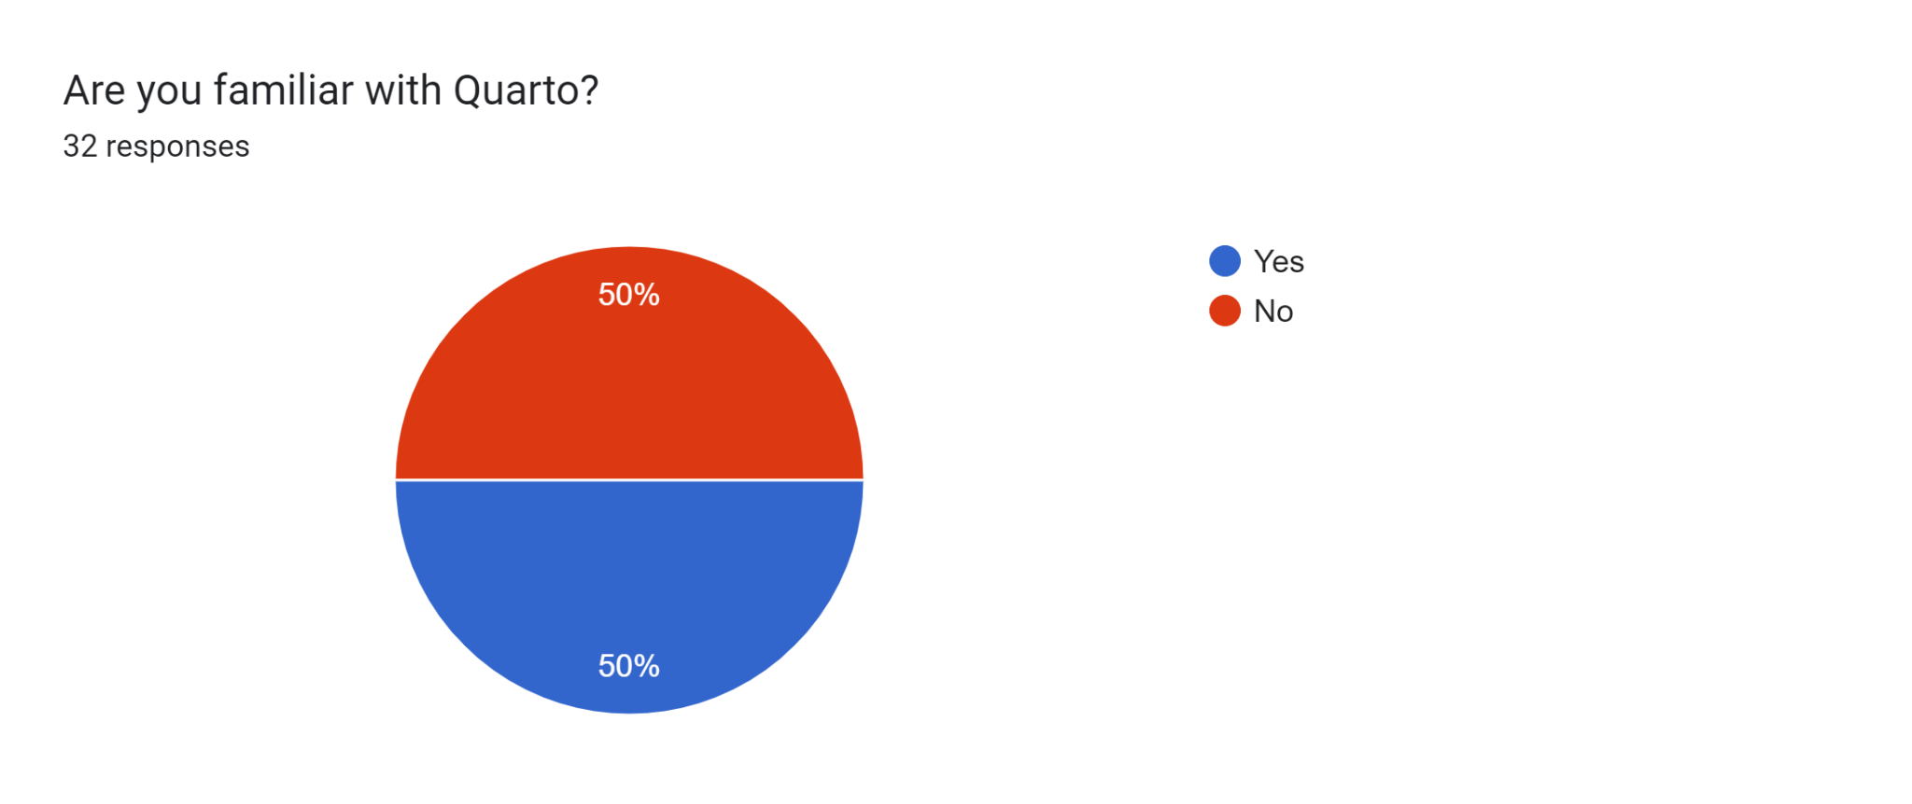
Survey Results
32 responses

Slide 5
Talk Session

Slide 6
Q & A

Slide 7


Slide 8
THANK YOU!!
Email address: nairobi@rladies.org
LinkedIn: R-Ladies Nairobi
Twitter: @RLadiesNairobi
Meetup: https://www.meetup.com/rladies-nairobi/

